Slide 1






EC2 Instance

Slide 2
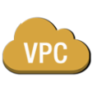





54.4.5.6
172.31.1.24
172.31.0.128
54.2.3.4
172.31.0.129
172.31.1.27
VPC

Slide 3
What to Expect from the Session
• Get familiar with VPC concepts
• Walk through a basic VPC setup
• Learn about the ways in which you
can tailor your virtual network to meet
your needs

Slide 4
Walkthrough: Setting up an
Internet-connected VPC

Slide 5

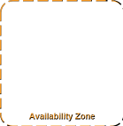
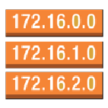

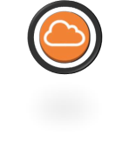
Creating an Internet-connected VPC: Steps
Choosing an
address range
Setting up subnets
in Availability Zones
Creating a route to
the Internet
Authorizing traffic
to/from the VPC

Slide 6

Choose address ranges

Slide 7
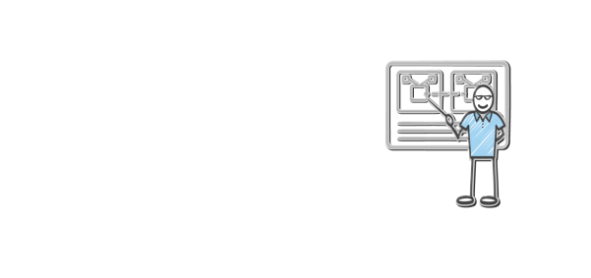
CIDR notation review
CIDR range example:
172.31.0.0/16
1010 1100 0001 1111 0000 0000 0000 0000

Slide 8


Choosing IP address ranges for your VPC
172.31.0.0/16
Recommended:
/16
(64K addresses)
Recommended:
RFC1918 range

Slide 9
Set up subnets

Slide 10
Choosing IP address ranges for your subnets
172.31.0.0/16
eu-west-1a
eu-west-1b
eu
-
west
-
1c
172.31.0.0/24
172.31.1
.0/24
172.31.2
.0/24
VPC subnet
VPC subnet
VPC subnet
Availability Zone
Availability Zone
Availability Zone

Slide 11
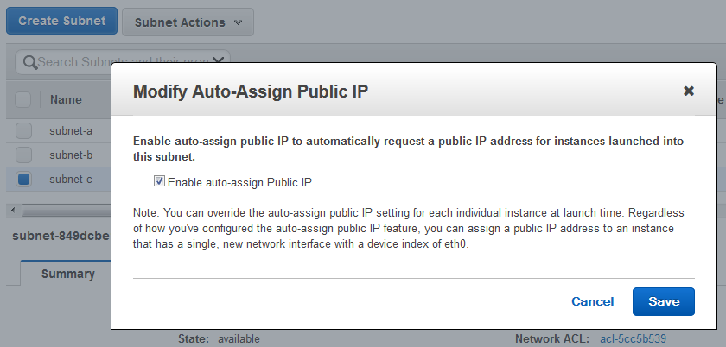

Auto-assign Public IP:
All instances will get an automatically assigned public IP

Slide 12

More on subnets
• Recommended for most customers:
• /16 VPC (64K addresses)
• /24 subnets (251 addresses)
• One subnet per Availability Zone
• When might you do something else?

Slide 13
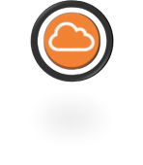
Create a route to the Internet

Slide 14

Routing in your VPC
• Route tables contain rules for which
packets go where
• Your VPC has a default route table
• … but you can assign different route
tables to different subnets

Slide 15
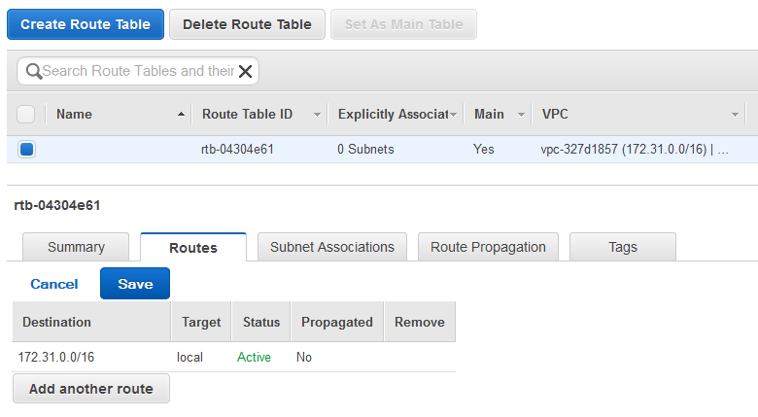


Traffic destined for my VPC
stays in my VPC

Slide 16
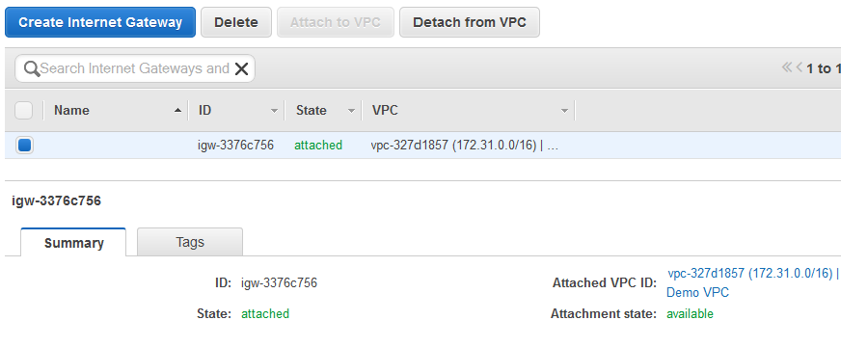
Internet gateway
Send packets here if you want
them to reach the Internet

Slide 17
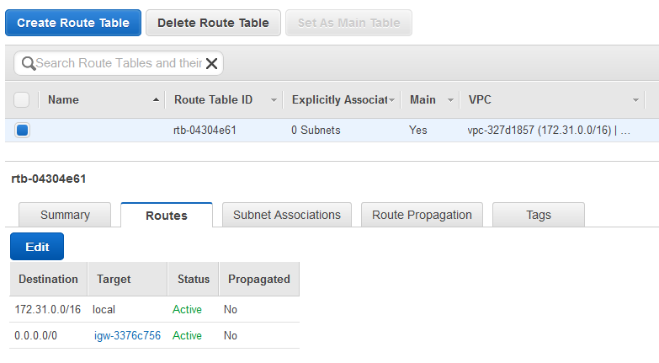


Everything that isn’t destined for the VPC:
Send to the Internet

Slide 18

Authorizing traffic:
Network ACLs
security groups

Slide 19
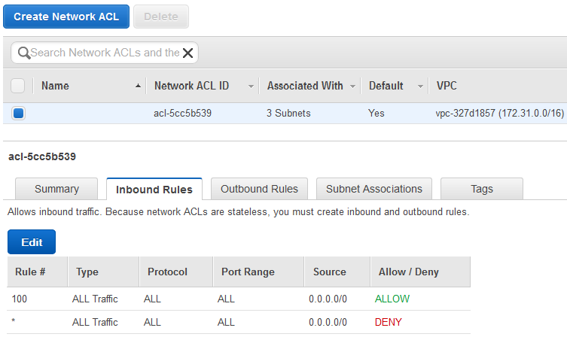

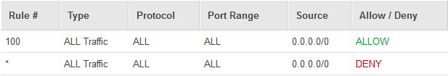
Network ACLs = stateless firewall rules
Can be applied on a subnet basis
English translation: Allow all traffic in

Slide 20






Security groups follow the structure of
your application
“MyWebServers” Security Group
Allow only “MyWebServers”
“MyBackends” Security Group

Slide 21
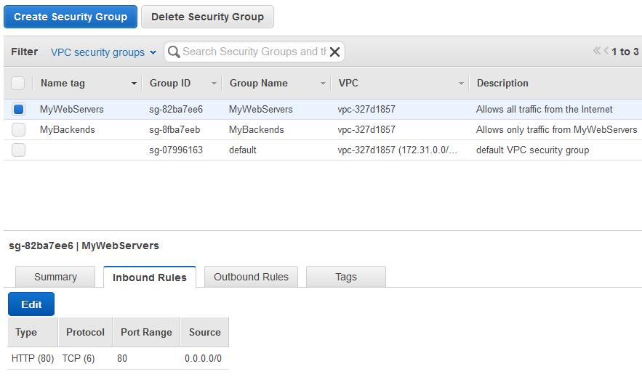


Security groups = stateful firewall
In English: Hosts in this group are reachable
from the Internet on port 80 (HTTP)

Slide 22
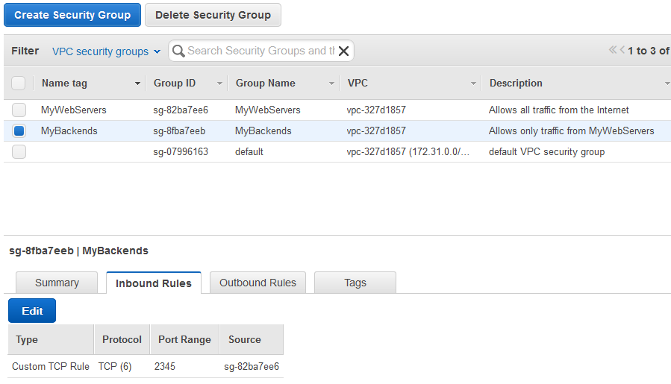


Security groups = stateful firewall
In English: Only instances in the MyWebServers
Security Group can reach instances in this
Security Group

Slide 23

Security groups in VPCs: Additional notes
• VPC allows creation of egress as well as ingress
security group rules
• Best practice: Whenever possible, specify allowed traffic
by reference (other security groups)
• Many application architectures lend themselves to a 1:1
relationship between security groups (who can reach
me) and AWS Identity and Access Management (IAM)
roles (what I can do).

Slide 24
Connectivity options for VPCs

Slide 25
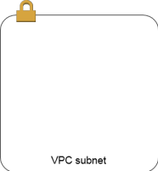


Beyond Internet connectivity
Connecting to other
VPCs
Connecting to your
corporate network
Subnet routing options

Slide 26
Routing on a subnet basis:
Internal-facing subnets

Slide 27




Different route tables for different subnets
Has route to Internet
VPC subnet
Has no route to Internet
VPC subnet

Slide 28






NAT access to Internet
Amazon-provided NAT
instance image:
amzn-ami-vpc-nat
0.0.0.0/0
0.0.0.0/0
NAT
VPC subnet
VPC subnet

Slide 29

Connecting to other VPCs:
VPC peering

Slide 30
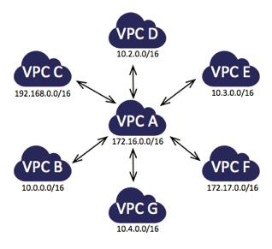
Shared services VPC using VPC peering
Common/core services
• Authentication/directory
• Monitoring
• Logging
• Remote administration
• Scanning

Slide 31





VPC peering
172.31.0.0/16
10.55.0.0/16
VPC Peering

Slide 32
Steps to establish a peering: Initiate request
172.31.0.0/16
10.55.0.0/16
Step 1
Initiate peering request

Slide 33
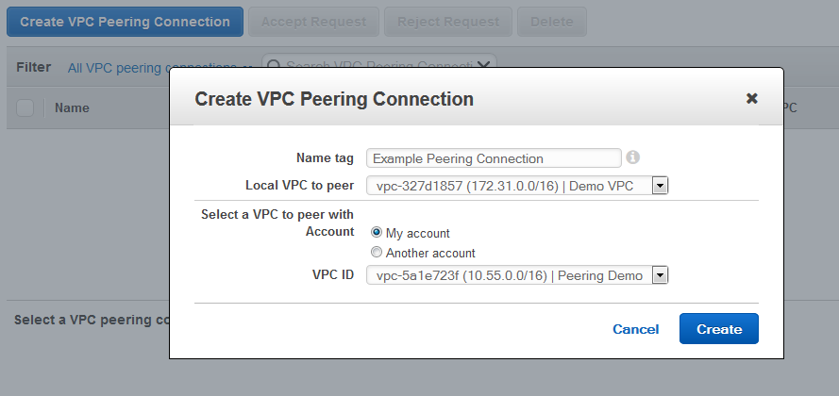
Steps to establish a peering: Initiate request

Slide 34
Steps to establish a peering: Accept request
172.31.0.0/16
10.55.0.0/16
Step 1
Initiate peering request
Step 2
Accept peering request

Slide 35
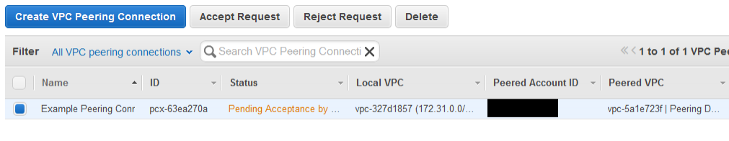

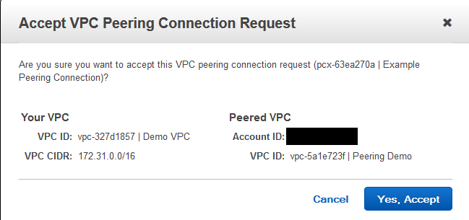
Steps to establish a peering: Accept request

Slide 36

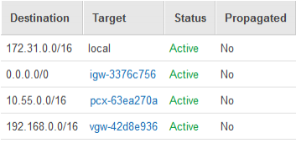

Steps to establish a peering: Create route
172.31.0.0/16
Step 1
10.55.0.0/16
In English: Traffic destined for the
peered VPC should go to the peering
Initiate peering request
Step 2
Accept peering request
Step 3
Create routes

Slide 37

Connecting to your network:
AWS Hardware VPN &
AWS Direct Connect

Slide 38






Extend your own network into your VPC
VPN
Direct Connect

Slide 39





VPN: What you need to know
192.168.0.0/16
172.31.0.0/16
Customer
Gateway
Virtual
Gateway
192.168/16
Two IPSec tunnels
Your networking device

Slide 40
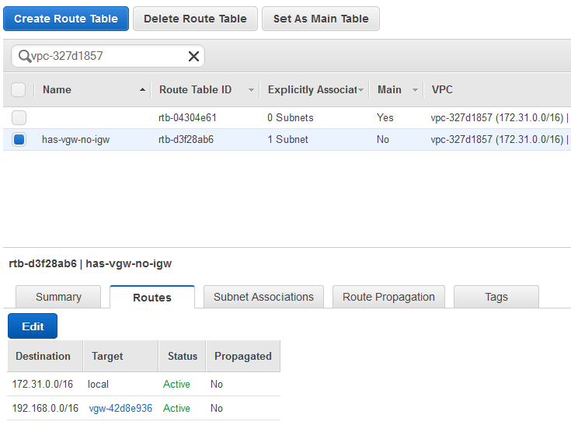

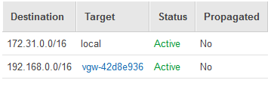
Routing to a virtual private gateway
In English: Traffic to my 192.168.0.0/16
network goes out the VPN tunnel

Slide 41


VPN vs. Direct Connect
• Both allow secure connections
between your network and your VPC
• VPN is a pair of IPSec tunnels over
the Internet
• Direct Connect is a dedicated line
with lower per-GB data transfer rates
• For highest availability: Use both

Slide 42
DNS in a VPC

Slide 43
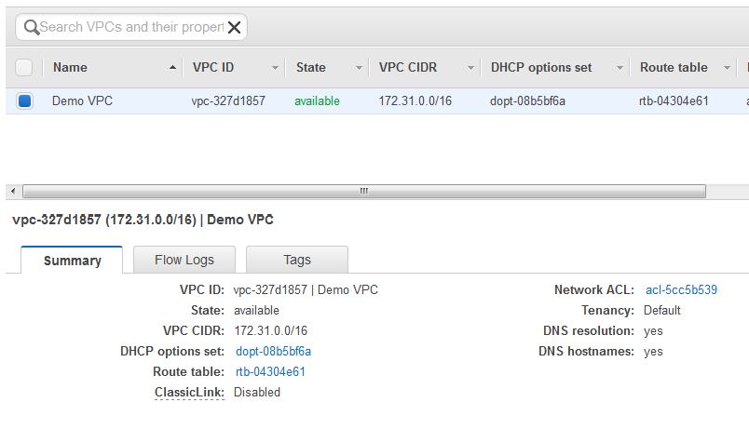
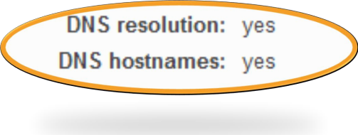
VPC DNS options
Use Amazon DNS server
Have EC2 auto-assign DNS
hostnames to instances

Slide 44
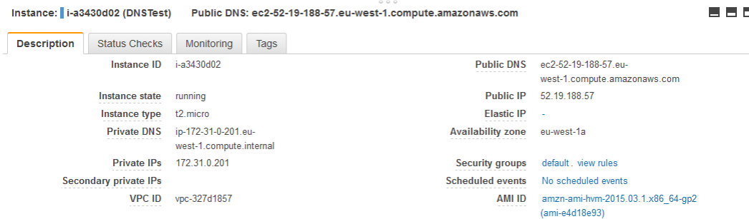
EC2 DNS hostnames in a VPC
External DNS name: Resolves to…
Internal DNS hostname:
Resolves to Private IP address

Slide 45
EC2 DNS hostnames work from anywhere:
Outside your VPC
C:\>nslookup ec2-52-18-10-57.eu-west-1.compute.amazonaws.com
Server: globaldnsanycast.amazon.com
Address: 10.4.4.10
Outside your VPC:
PublicIP address
Non-authoritative answer:
Name: ec2-52-18-10-57.eu-west-1.compute.amazonaws.com
Address: 52.18.10.57

Slide 46
EC2 DNS hostnames work from anywhere:
Inside your VPC
[ec2-user@ip-172-31-0-201 ~]$ dig ec2-52-18-10-57.eu-west-1.compute.amazonaws.com
; <<>> DiG 9.8.2rc1-RedHat-9.8.2-0.30.rc1.38.amzn1 <<>> ec2-52-18-10-57.eu-west-
1.compute.amazonaws.com
;; global options: +cmd
;; Got answer:
;; ->>HEADER<<- opcode: QUERY, status: NOERROR, id: 36622
Inside your VPC:
Private IP address
;; flags: qr rd ra; QUERY: 1, ANSWER: 1, AUTHORITY: 0, ADDITIONAL: 0
;; QUESTION SECTION:
;ec2-52-18-10-57.eu-west-1.compute.amazonaws.com. IN A
;; ANSWER SECTION:
ec2-52-18-10-57.eu-west-1.compute.amazonaws.com. 60 IN A 172.31.0.137
;; Query time: 2 msec
;; SERVER: 172.31.0.2#53(172.31.0.2)
;; WHEN: Wed Sep 9 22:32:56 2015
;; MSG SIZE rcvd: 81

Slide 47

Amazon Route 53 private hosted zones
• Control DNS resolution for a domain and
subdomains
• DNS records take effect only inside
associated VPCs
• Can use it to override DNS records “on the
outside”

Slide 48

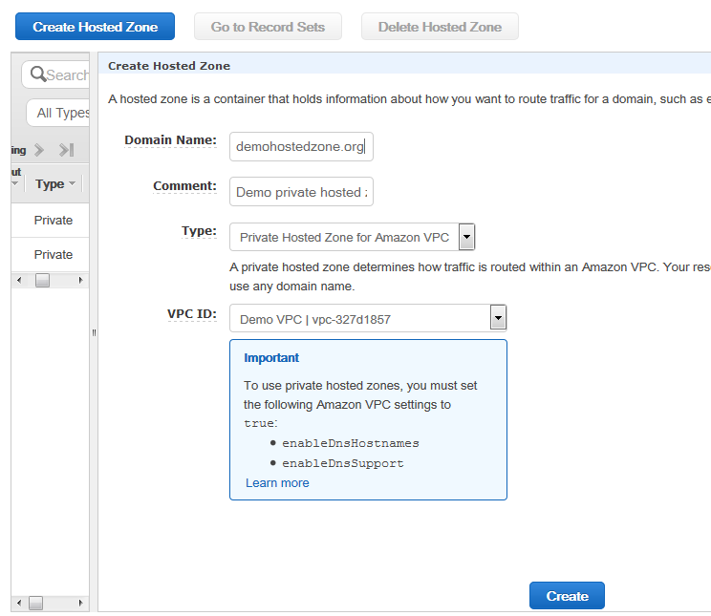

Creating an Amazon Route 53 private hosted
zone
Private Hosted Zone
Associated with one
or more VPCs

Slide 49
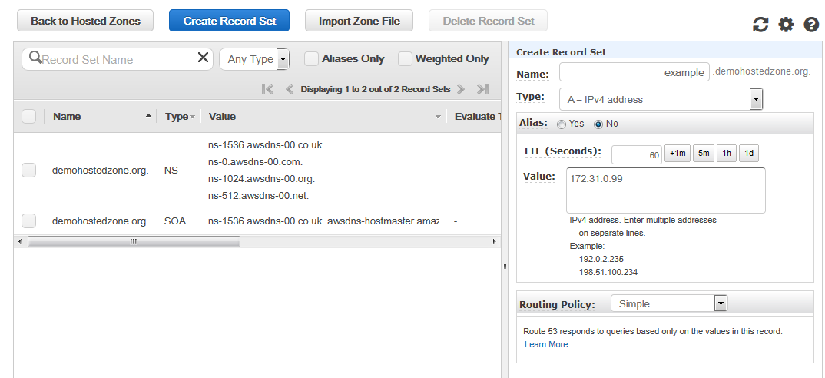
Creating an Amazon Route 53 DNS record
Private Hosted
Zone
example.demohostedzone.org →
172.31.0.99

Slide 50

Querying private hosted zone records
https://aws.amazon.com/amazon-linux-ami/2015.03-release-notes/
[ec2-user@ip-172-31-0-201 ~]$ dig example.demohostedzone.org
; <<>> DiG 9.8.2rc1-RedHat-9.8.2-0.30.rc1.38.amzn1 <<>> example.demohostedzone.org
;; global options: +cmd
;; Got answer:
;; ->>HEADER<<- opcode: QUERY, status: NOERROR, id: 26694
;; flags: qr rd ra; QUERY: 1, ANSWER: 1, AUTHORITY: 0, ADDITIONAL: 0
;; QUESTION SECTION:
;example.demohostedzone.org. IN A
;; ANSWER SECTION:
example.demohostedzone.org. 60 IN A 172.31.0.99
;; Query time: 2 msec
;; SERVER: 172.31.0.2#53(172.31.0.2)
;; WHEN: Wed Sep 9 00:13:33 2015
;; MSG SIZE rcvd: 60

Slide 51
And so much more

Slide 52








VPC Flow Logs: See all your traffic
•
Visibility into effects of
security group rules
•
Troubleshooting network
connectivity
•
Ability to analyze traffic

Slide 53


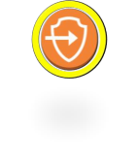



Amazon VPC endpoints: Amazon S3
without an Internet gateway

Slide 54

ClassicLink: Connect EC2-Classic instances to
your VPC
• Connectivity over private IP address
between linked instances in EC2-
Classic and VPC
• Classic instances can take
membership in VPC security groups

Slide 55
Related Sessions
NET301
Next Gen Networking:
Virtual Private Cloud
•
-
New Capabilities for Amazon
•
NET307
-
Pinterest: The Road From EC2
-
Classic to EC2
-
VPC
•
NET402
53
-
Consolidating DNS Data in the Cloud with Amazon Route
•
NET403
-
Another Day,
Another Billion Packets
•
NET404
-
Making Every Packet Count
•
NET406
-
Deep Dive: AWS Direct
Connect
and VPNs
•
NET409
-
Movin’ On Up to Amazon VPC: How Twilio Migrated Its
Services from EC2-Classic to EC2-VPC

Slide 56
Manage your network like a boss…
54.4.5.6
172.31.1.24
172.31.0.128
54.2.3.4
172.31.0.129
172.31.1.27
… whether or not you’re a networking expert

Slide 57
Thank you!

